Slide 1

Furry Friends Wellness Suite
Haneesh Raj Banisetti
Chaitanya Sai Gandi
Yihan Li
Yiyang Alison Xu

Slide 2
Meet Our Team
Haneesh Raj Banisetti
Chaitanya Sai Gandi
Yihan Li
Yiyang Alison Xu

Slide 3



Agenda
PROJECT INTRODUCTION
FRAMEWORK
USE CASE
CLASS DIAGRAM
DESIGN PATTERN
APPLICATION DEMO

Slide 4


Your One-stop Solution for Pet Wellness: Easy Booking for customer and Easy Management for our employees
Furry Friends Wellness Suite

Slide 5






PROJECT FRAMEWORK
Backend and UI
Containerization
Database
Visualization

Slide 6
ROLES AND FUNCTIONALITIES
CUSTOMER (CUSTOMER)
Sign-up and Login with Email; Search Nearest Store; Create Pet Profile; Select Service; Confirm Booking; Get Signup and Confirmation Email;
STORE EMPLOYEE
(ADMIN)
Log-in Store Portal; Mark Appointment as Complete; Manage Customer Database
CLIENT INFO MANAGER
(STORE CUSTOMER)
Update Appointment Status; Help Customer Book Offline; Create Customer Profile; View Customer Appointment History;
Search by Customer ID.
SYSTEM ADMIN (ADMIN)
Create credentials; Manage System Admin; Manage Store Employees; Manage Store Service Manage Store Manage CIM

Slide 7
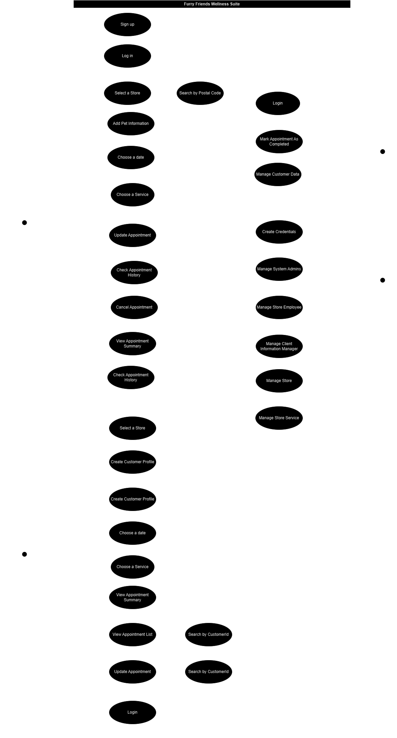
USE CASE DIAGRAM

Slide 8
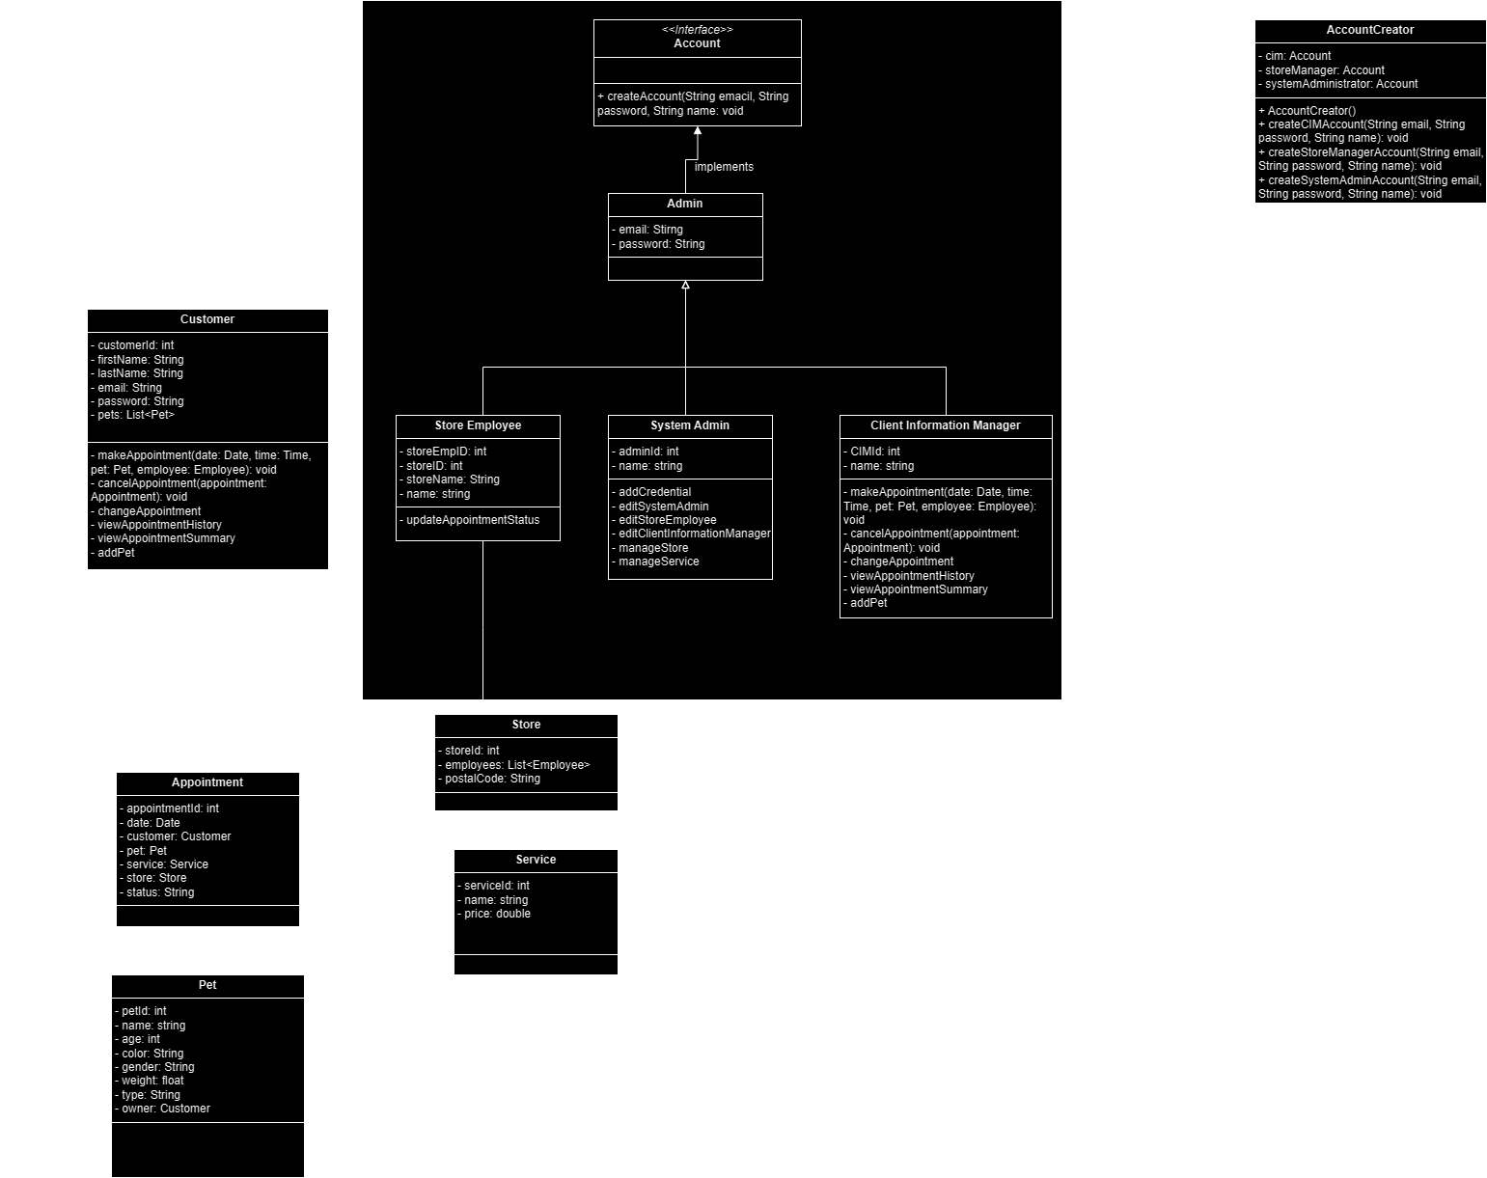
CLASS DIAGRAM

Slide 9
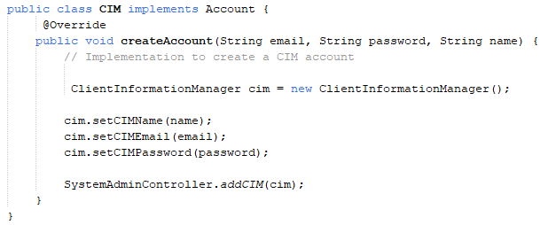
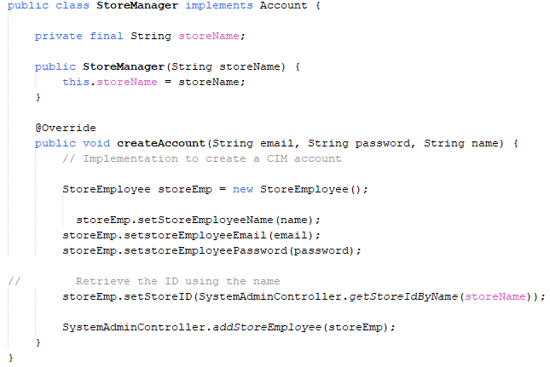
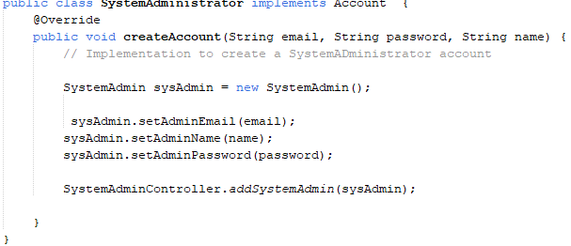
FAÇADE PATTERN
Account {
Void createCreator
}
Client Information Manager
Store Manager
System Administrator

Slide 10
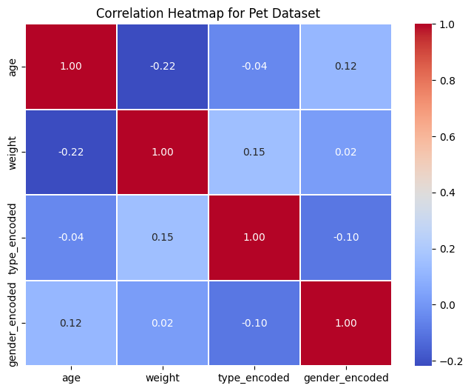
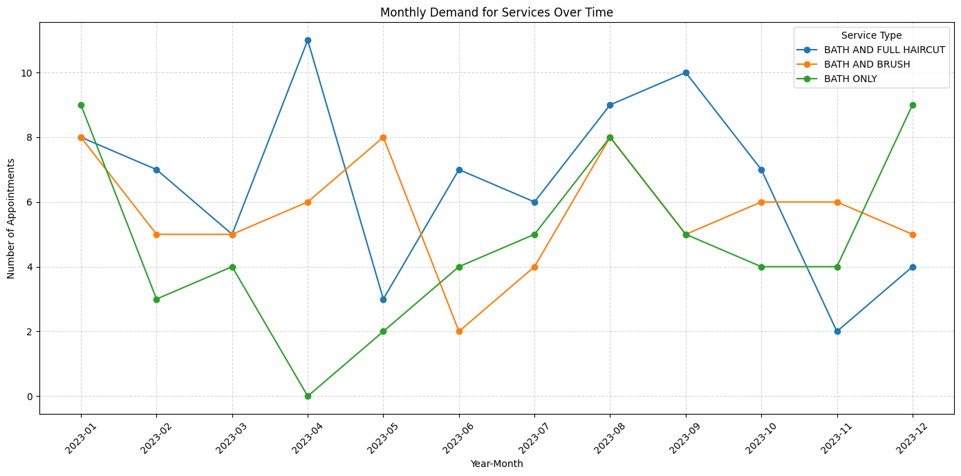
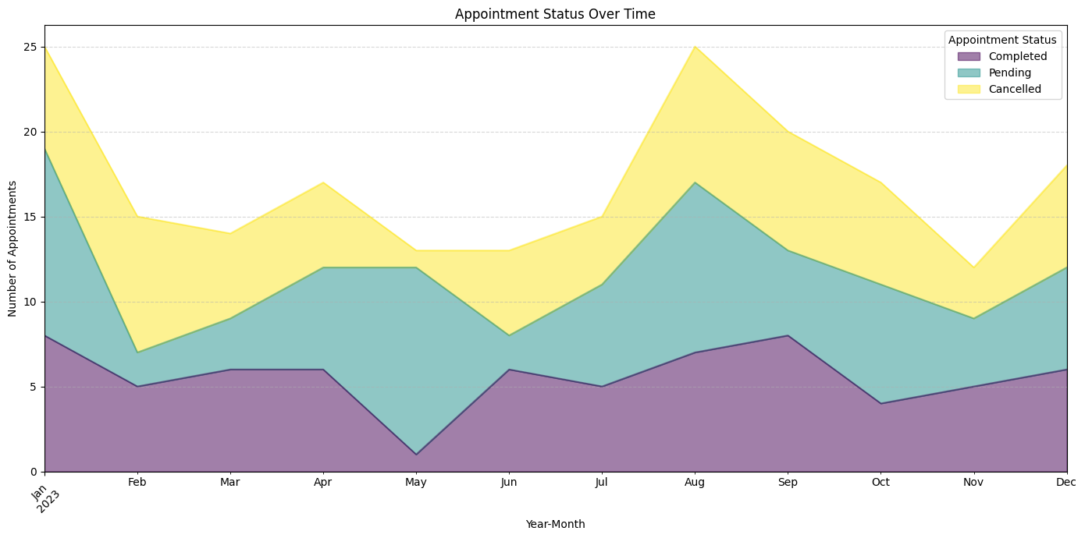
OUR SERVICES
POPULAR PET CARE PACKAGE
PET HEALTH ASSESSMENT

Slide 11
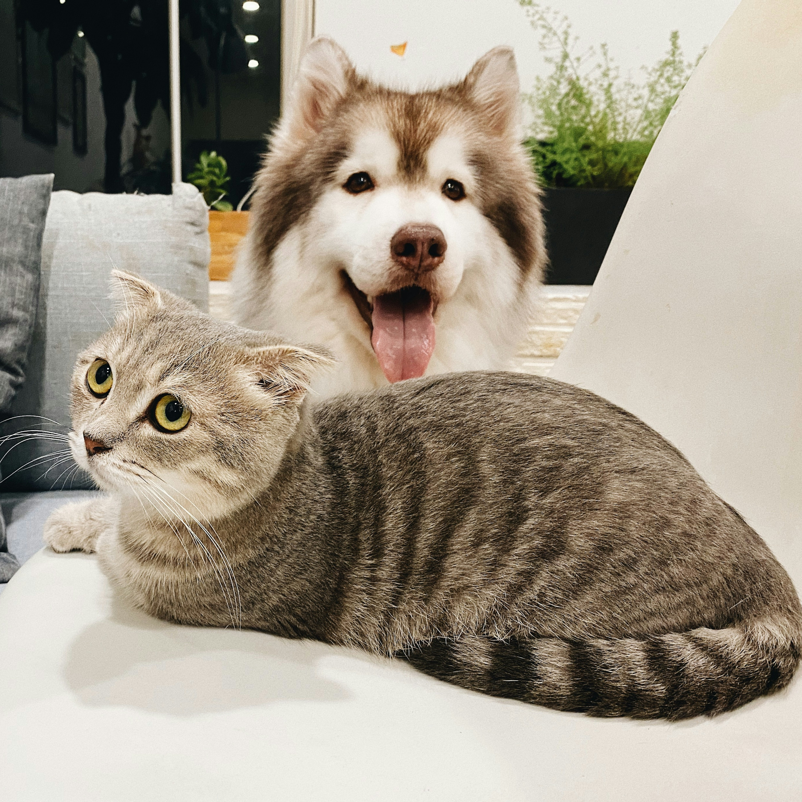
Summary
Furry Friends Wellness Suite is a one-stop application for both customer and FFWS offline stores!
Through customer portal, customer can sign-up, login, create pet profile, and set-up appointment at selected store.
With rich interface in store portal, our application also allows employees to easily manage all daily store task: from service to client info managing.

